Slide 1






QR Attendance System

Slide 2
Introduction
According to the project that has been given to us, the purpose of the project was to speed up the attendance system i.e. the QR system related to the educational environment by using AWS

Slide 3
Problem & Solution
The main problem is the QR load process is slow. we designed a system to check the performance
To create a fast QR attendance system using AWS services

Slide 4
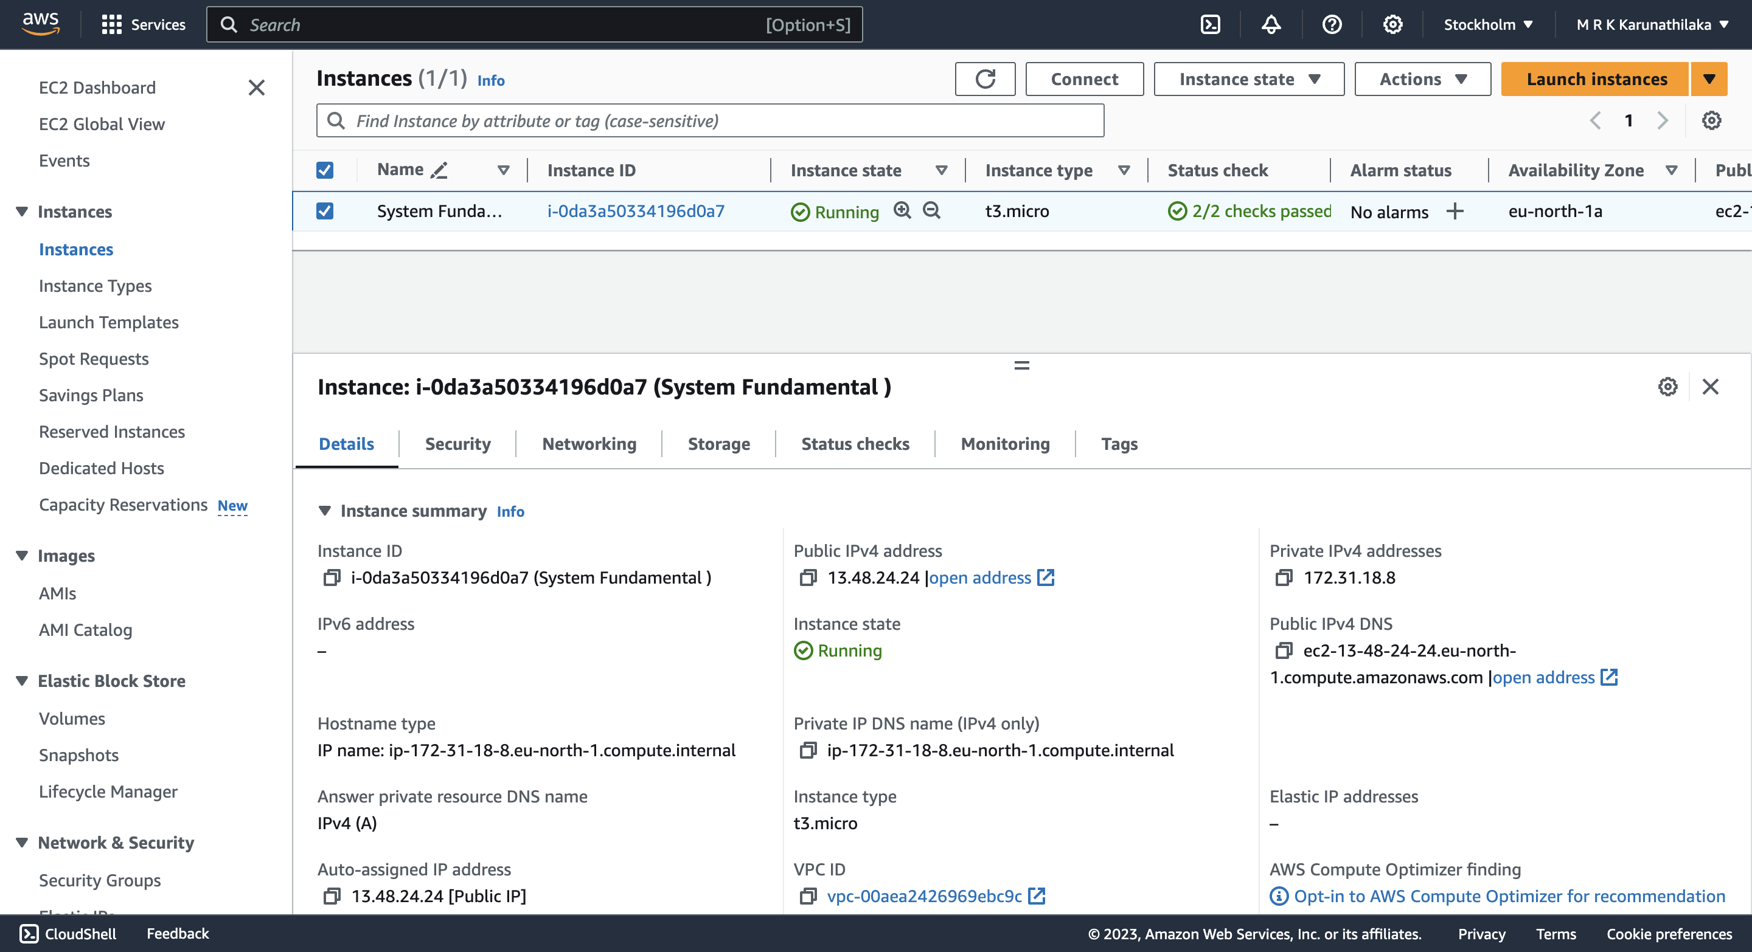
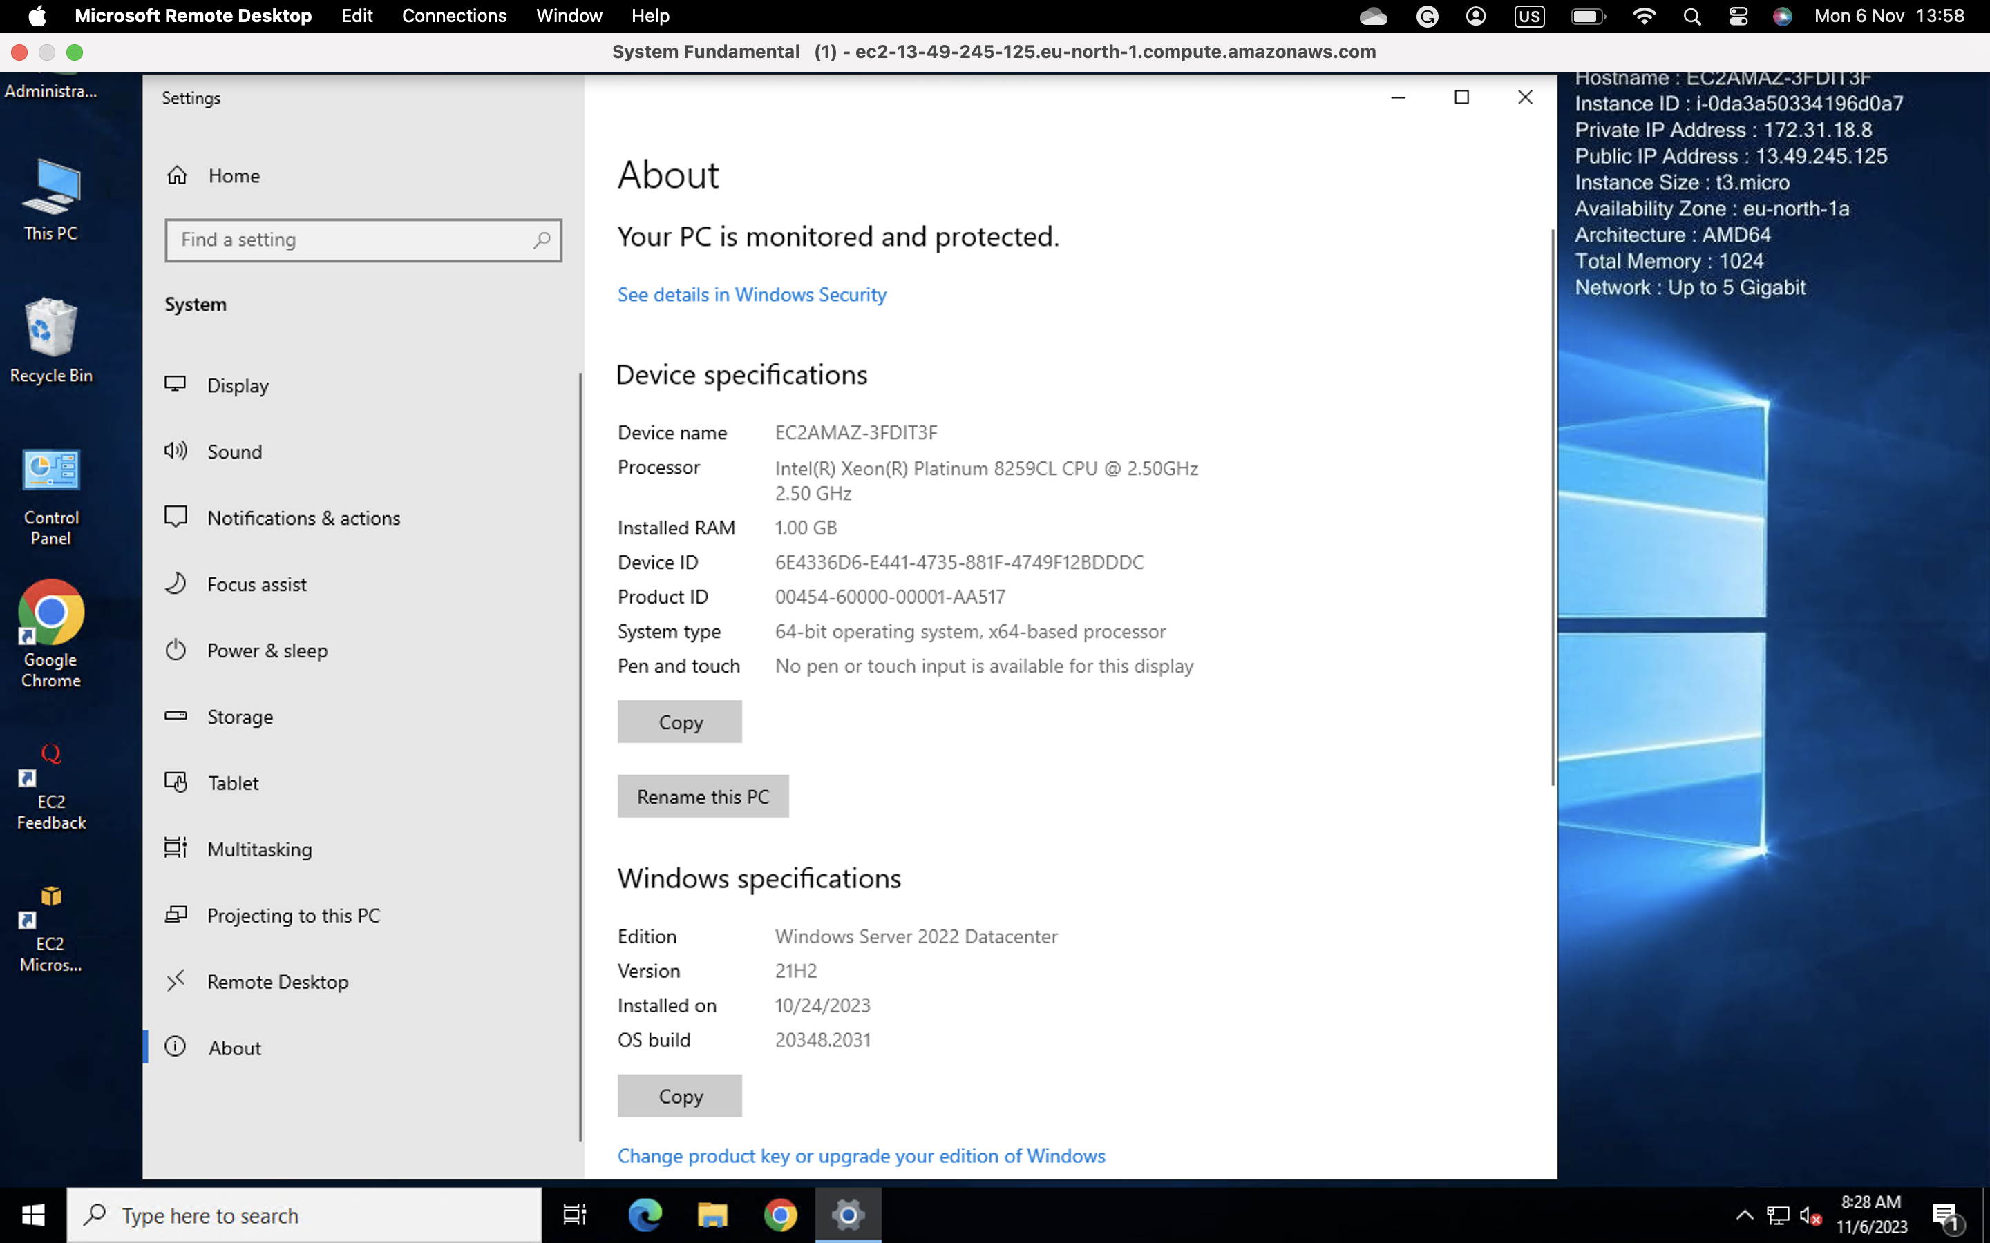
Project Timeline
1. Created AWS Free Tier Account.
2. Created Windows EC2 Instance.

Slide 5
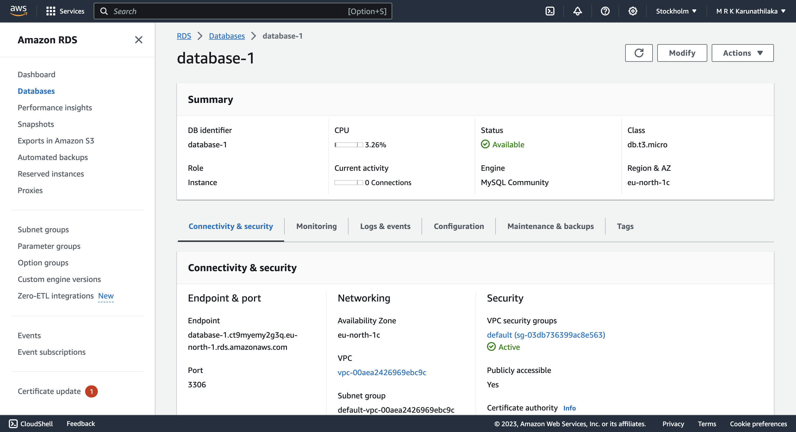
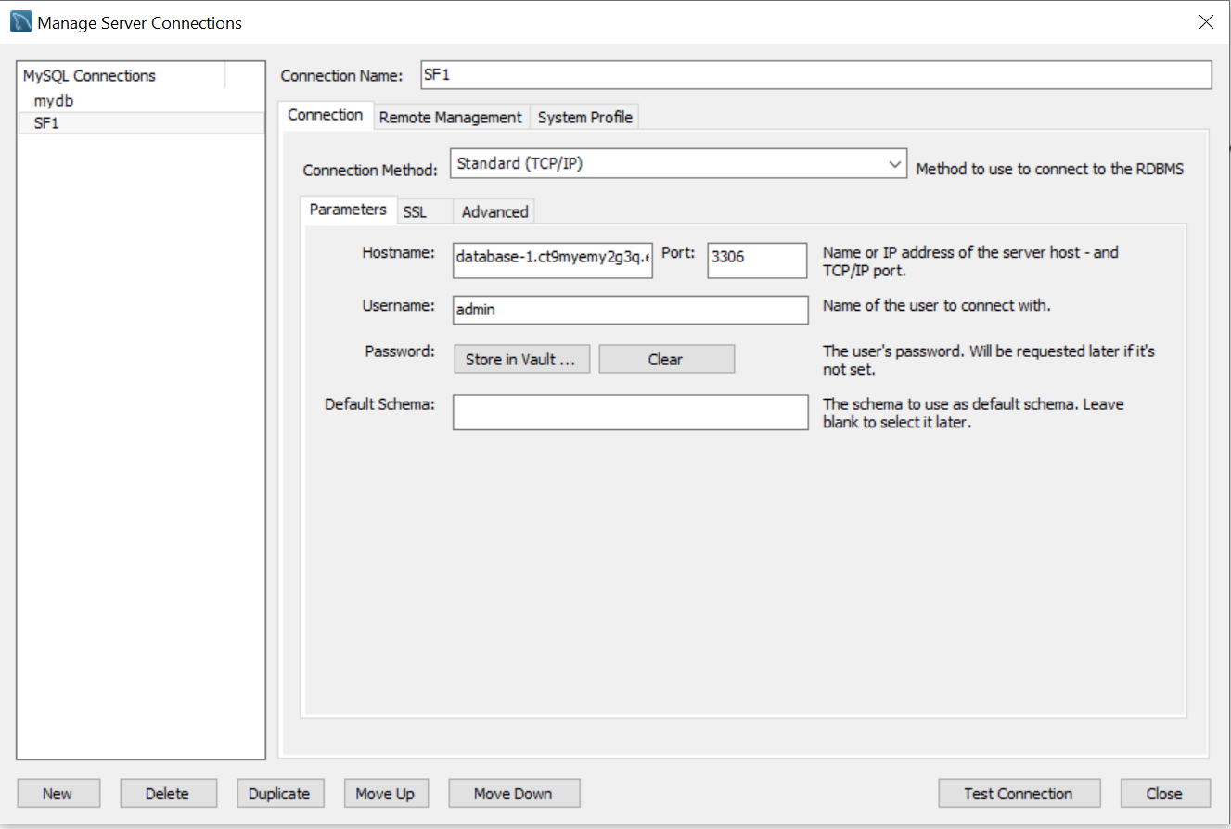
Project Timeline
3. Installed the PHP and Apache into the Virtual Machine.
4. Launched Apache server in the virtual machine.
5. Created MySQL database using AWS RDS service and logged in using MySQL Workbench.

Slide 6
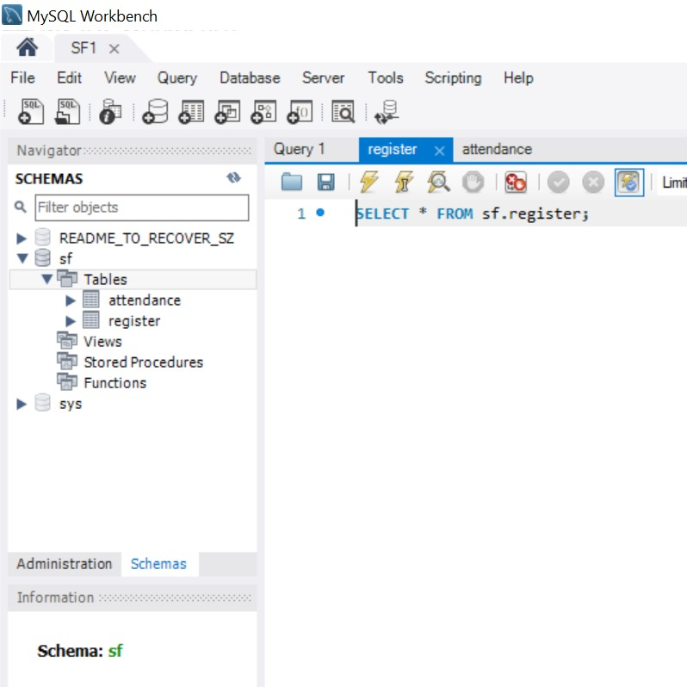
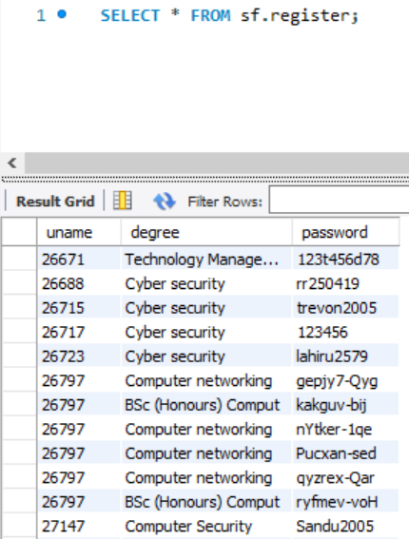
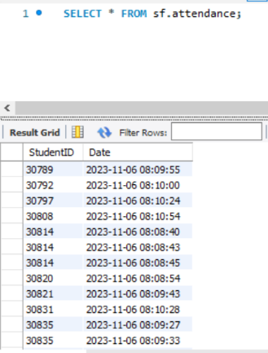
Project Timeline
6. Enabled port 8000 for the Apache server and port 3306 for MySQL in the security groups.
7. Created a database called SF and tables (register, attendance) with respective columns.
[Using MySQL Workbench]

Slide 7
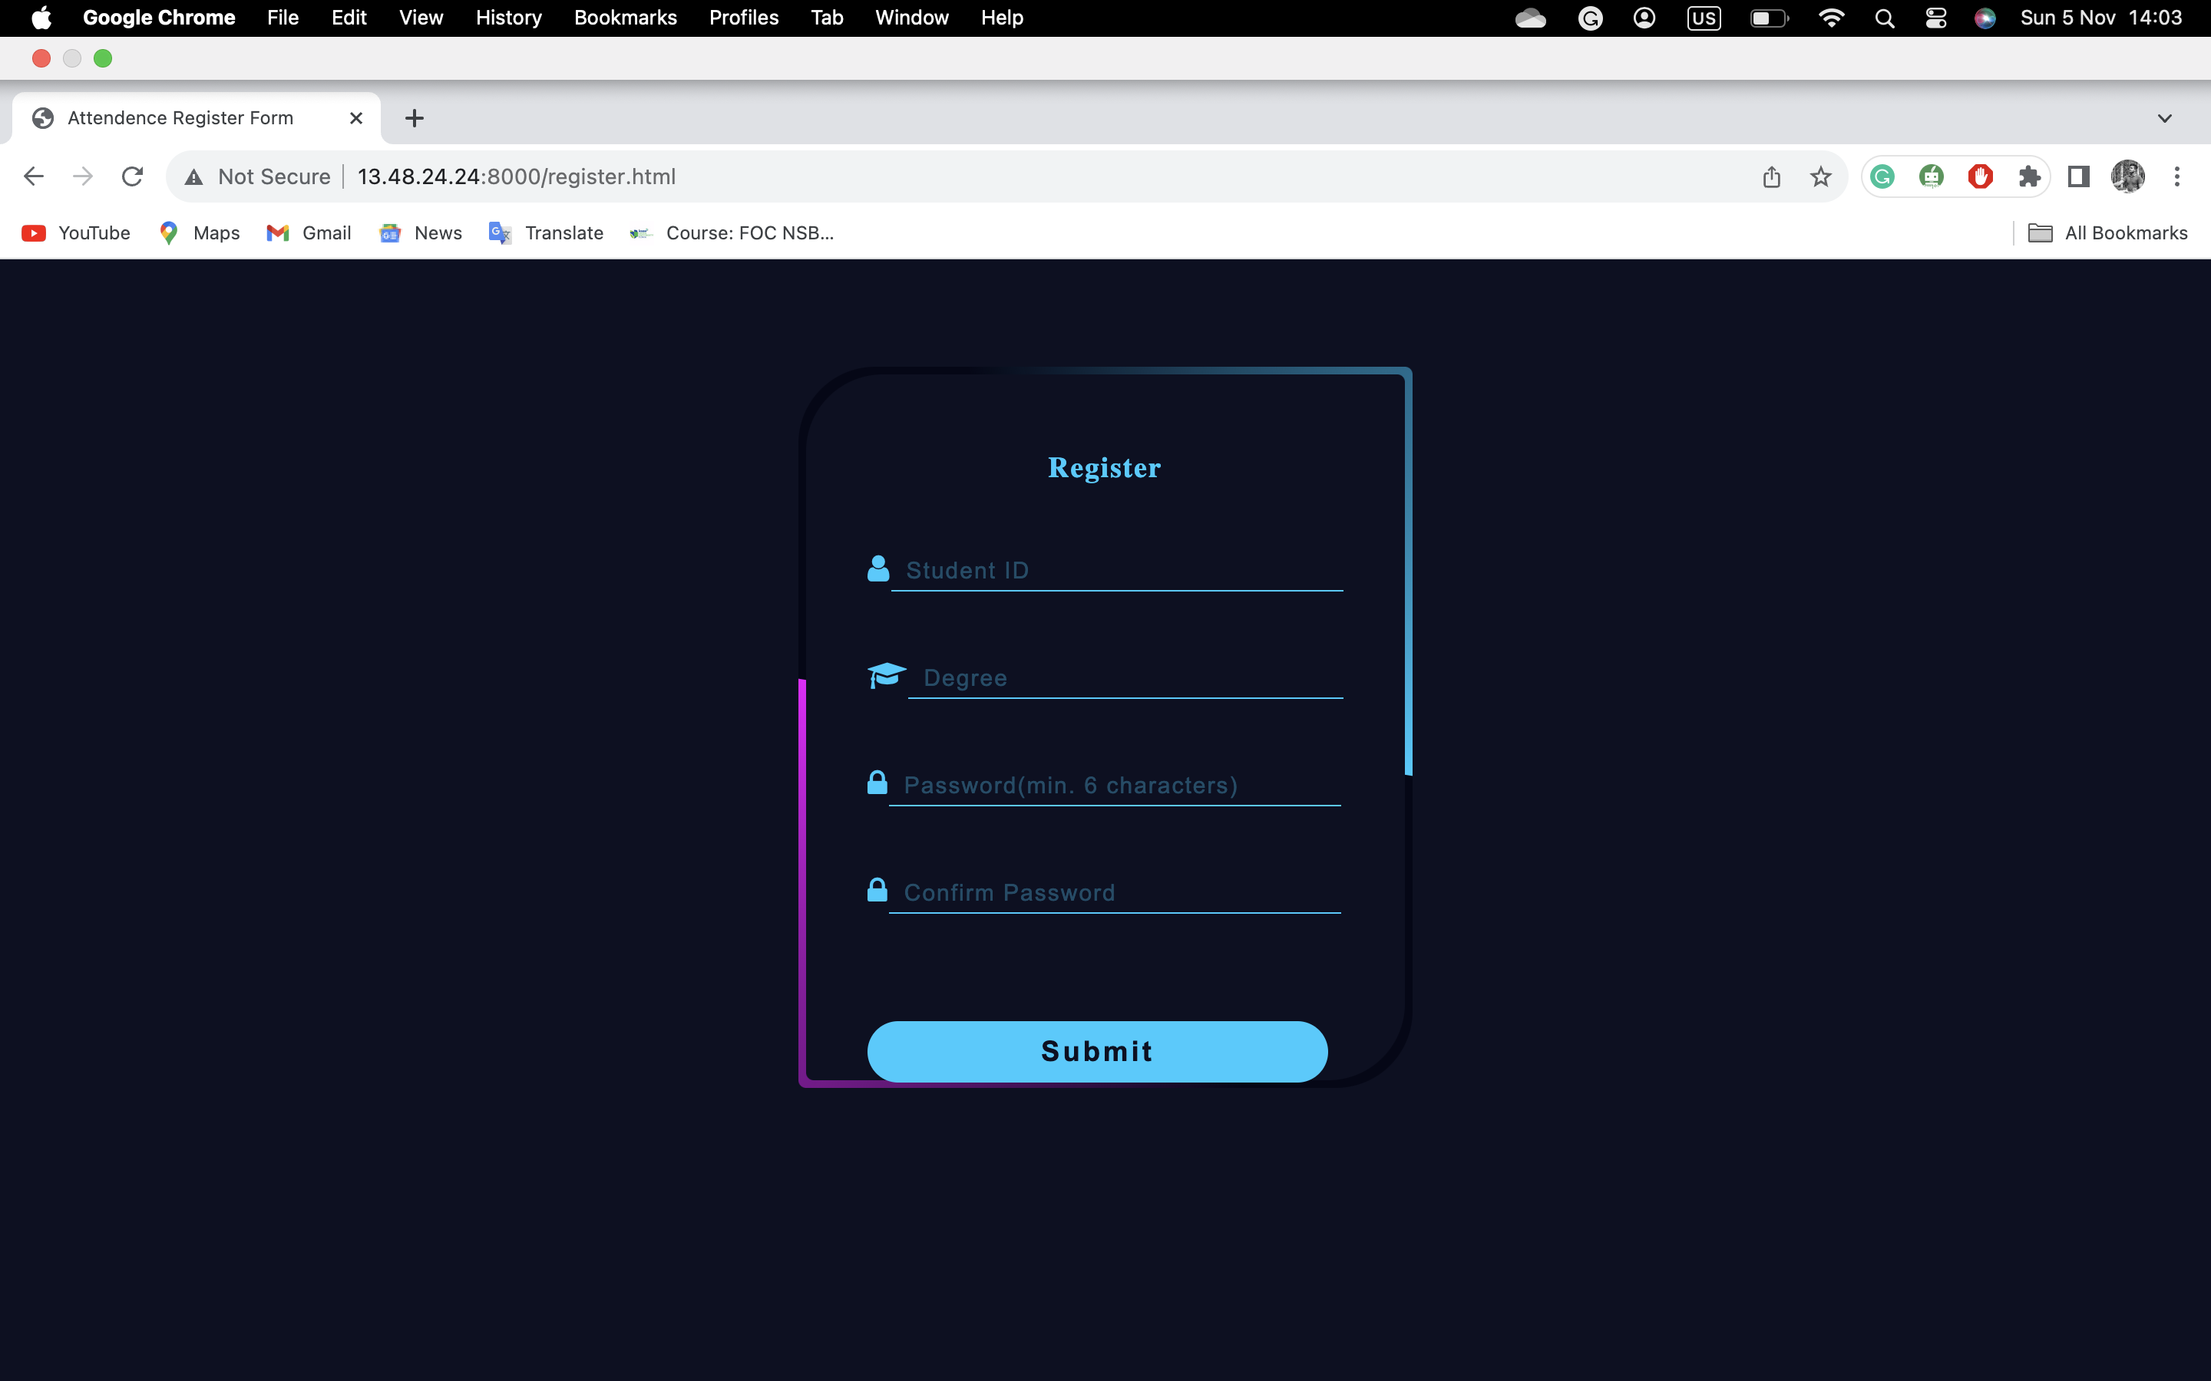
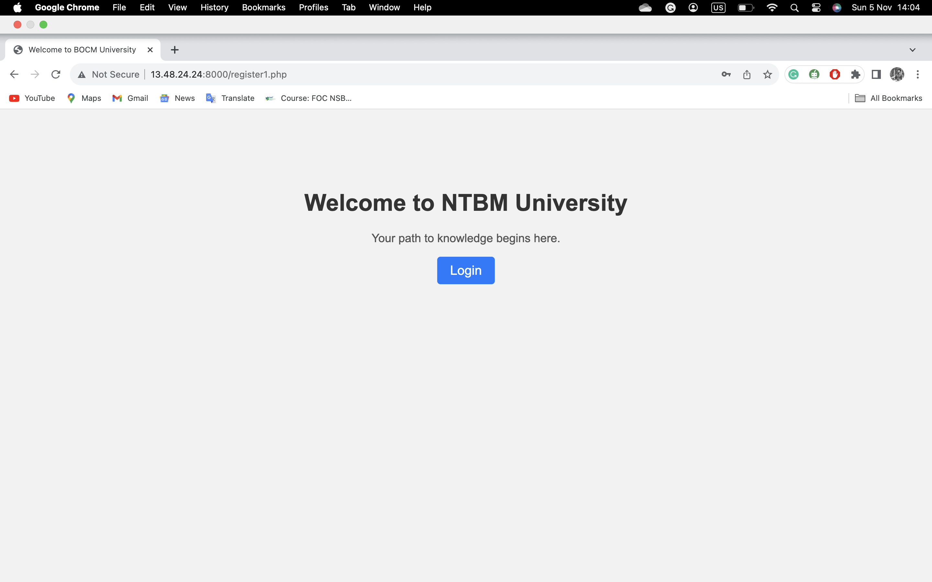
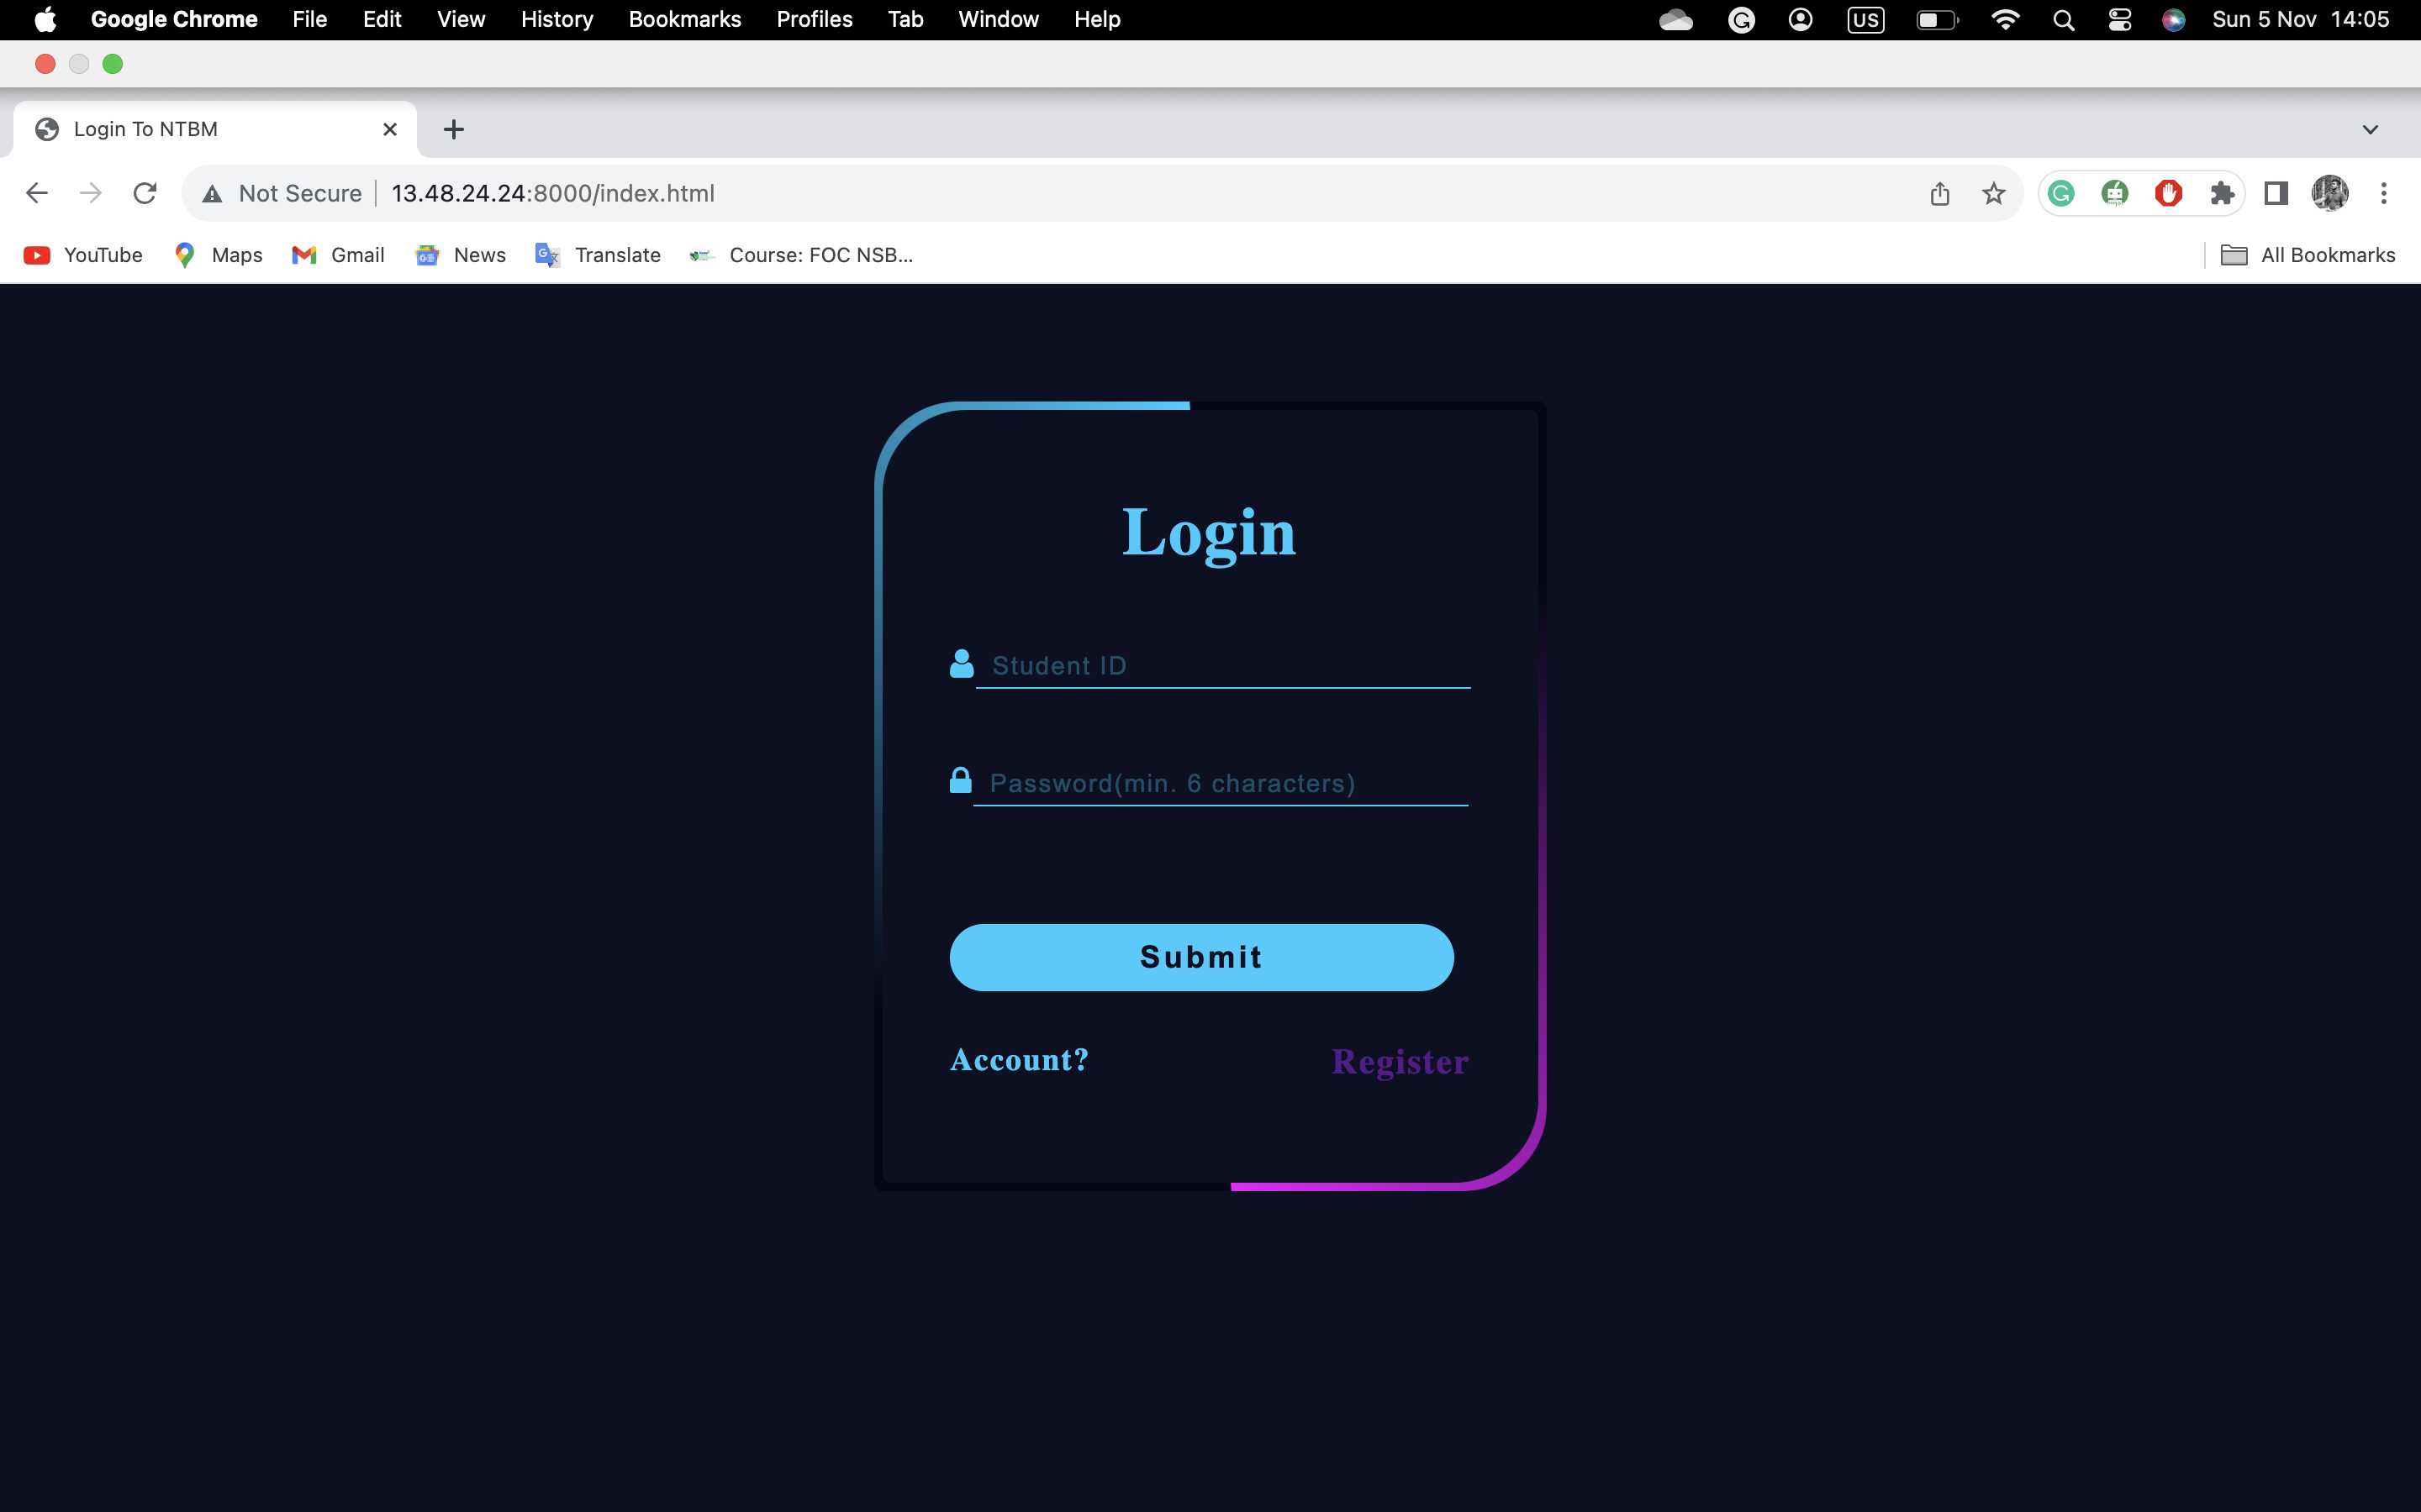
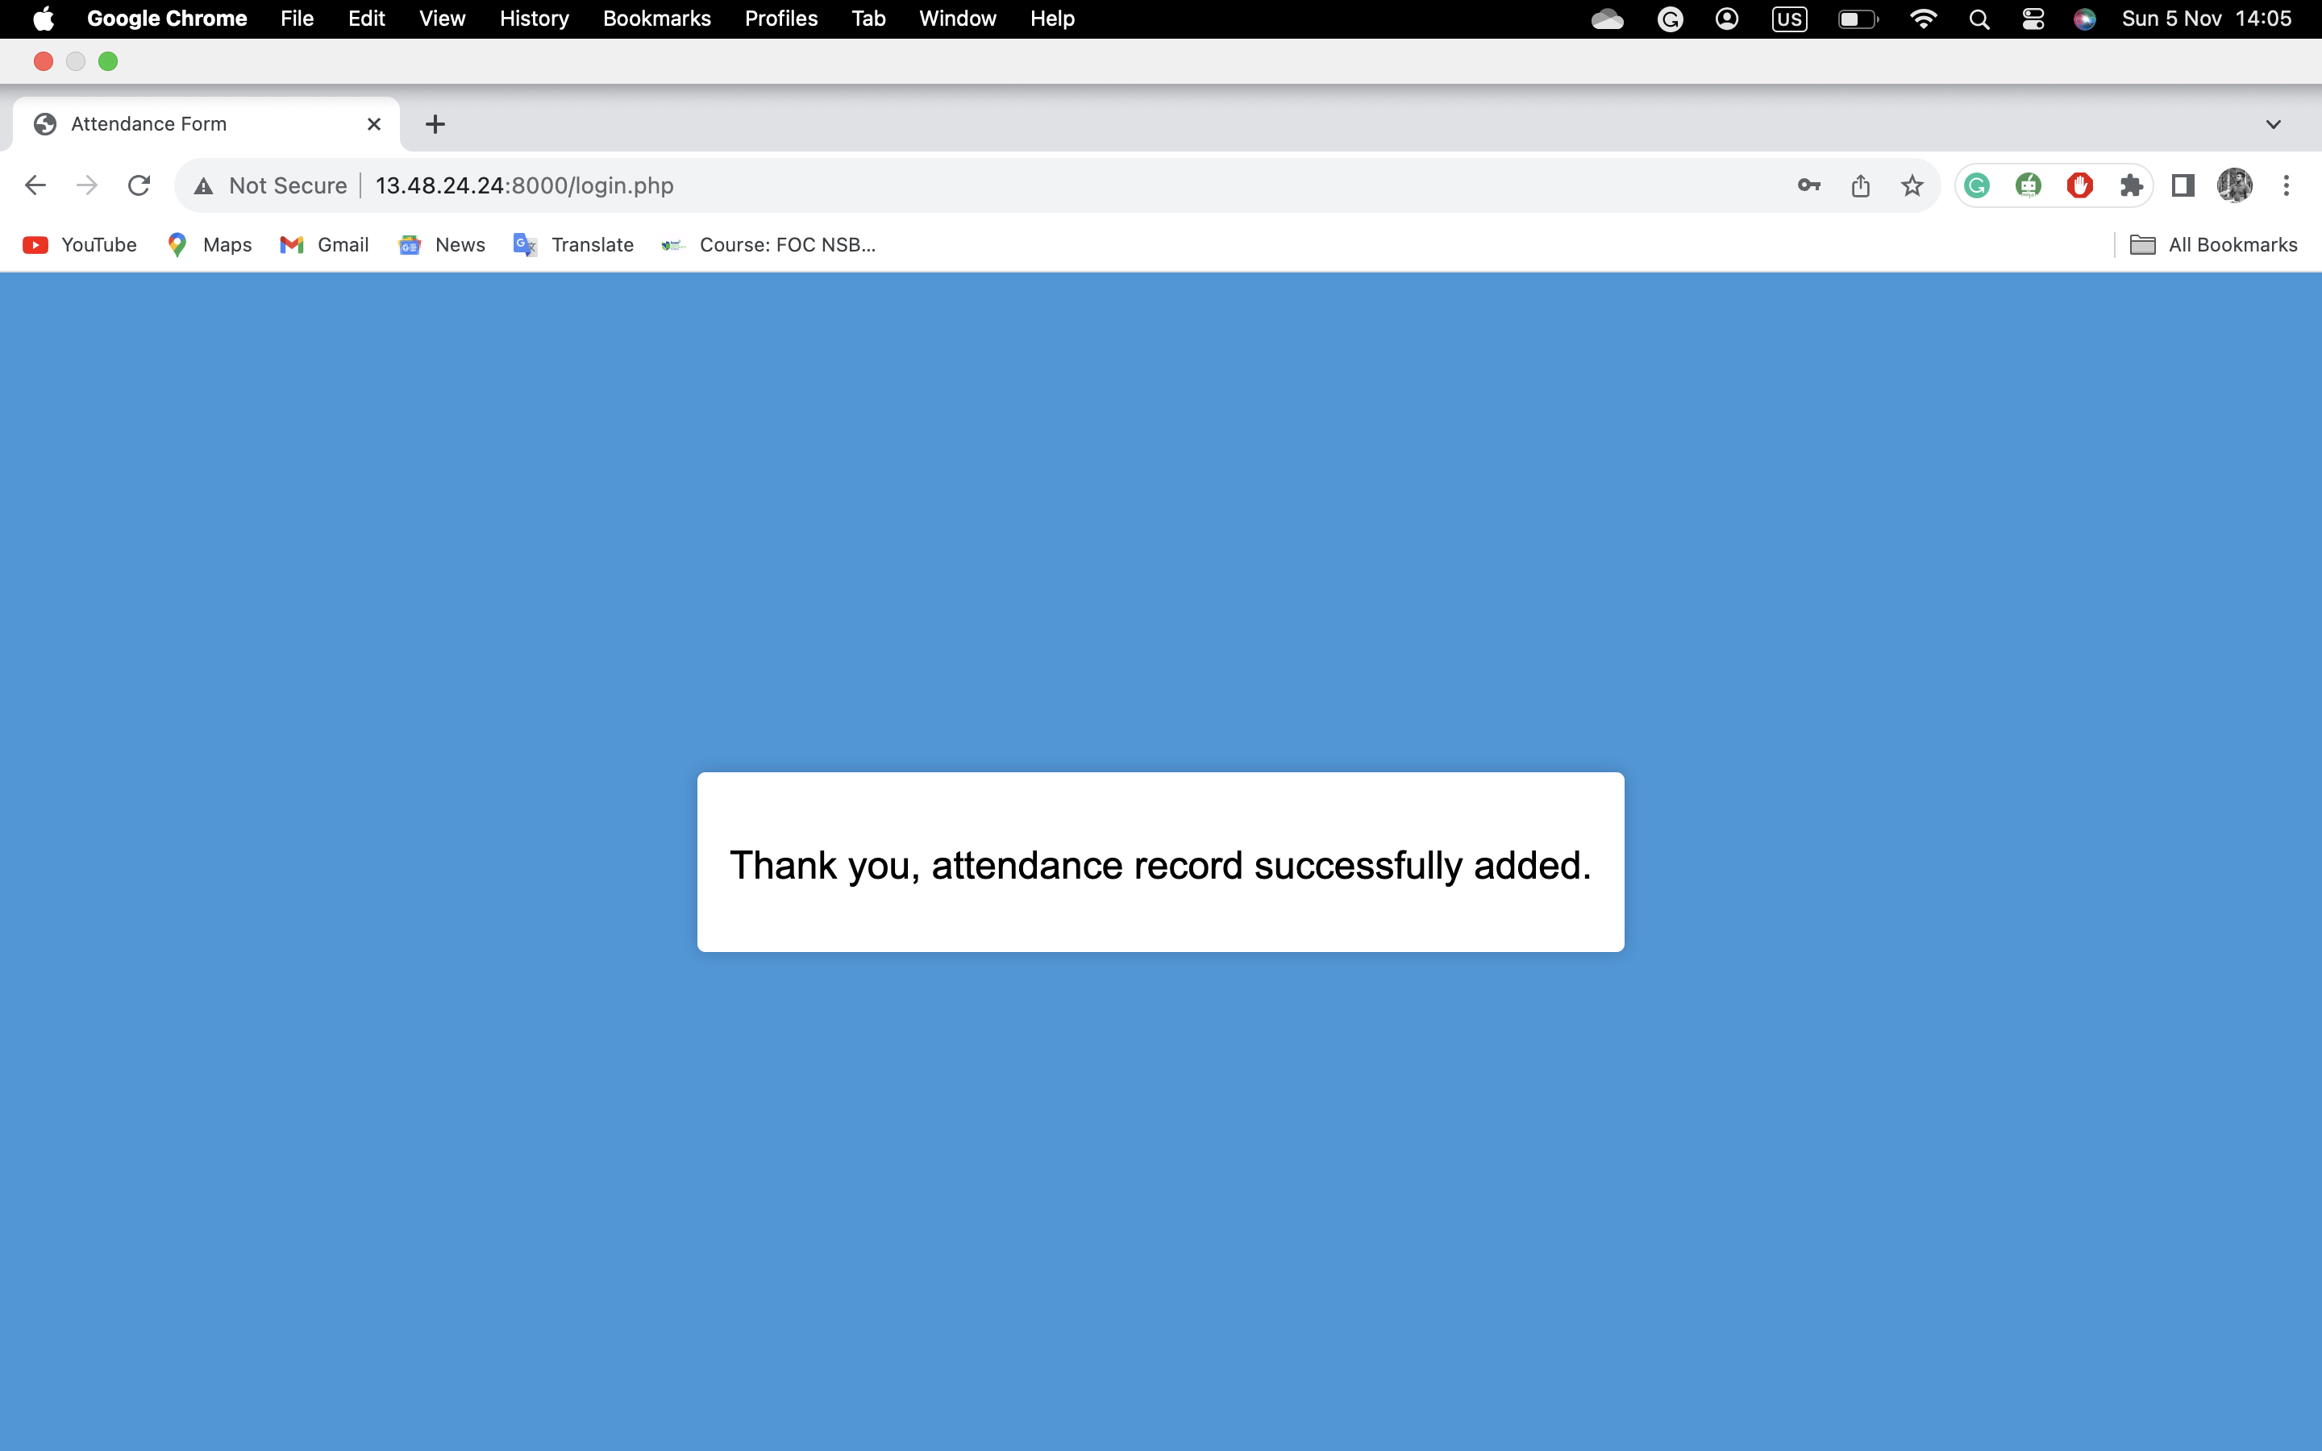
Project Timeline
8. Imported website files (HTML, CSS, JS, PHP) into Apache htdocs.
9. Successfully launched the complete website.

Slide 8

Scan the QR Code below to mark your attendance.

Slide 9
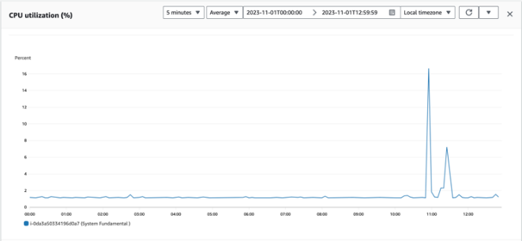
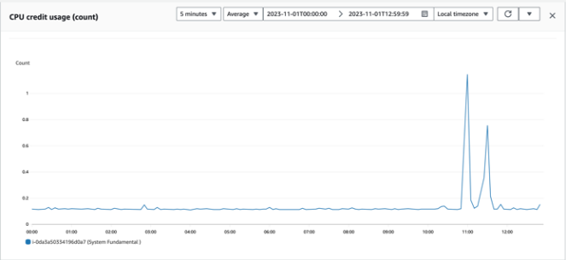
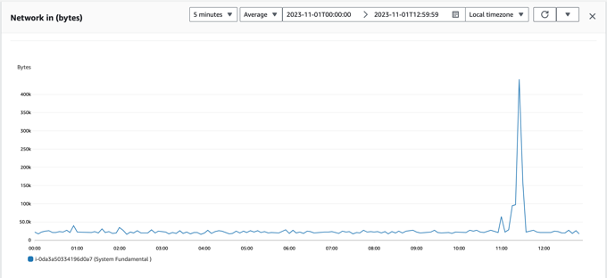
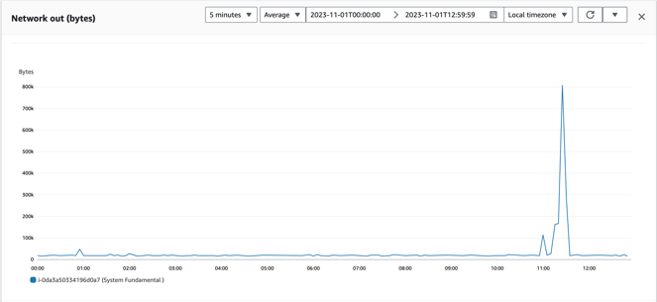
Performance Evaluation
Virtual Machine Performance
1. Conducted performance evaluation for 50 students

Slide 10
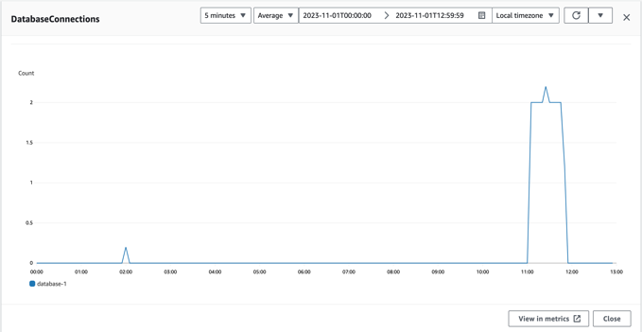
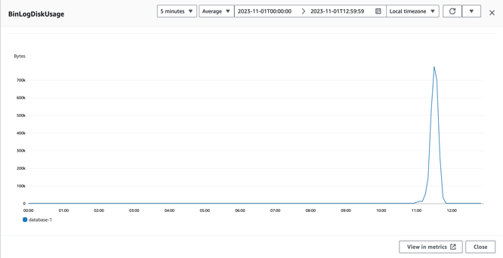
Performance Evaluation
Database Performance
1. Conducted performance evaluation for 50 students

Slide 11
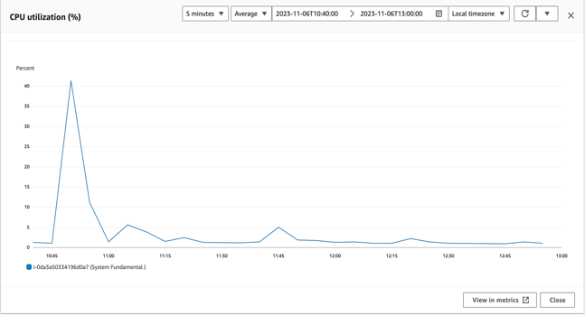
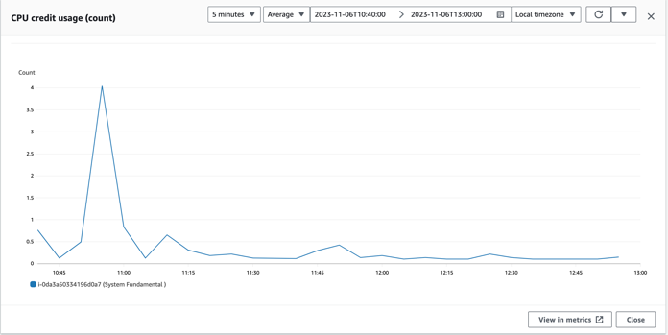
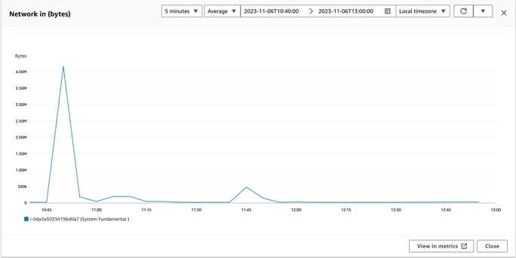
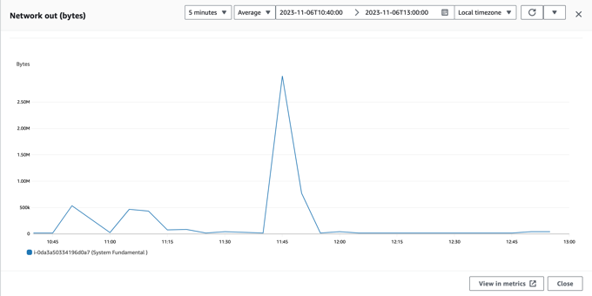
Performance Evaluation
Virtual Machine Performance
2. Conducted performance evaluation for 150 students.

Slide 12
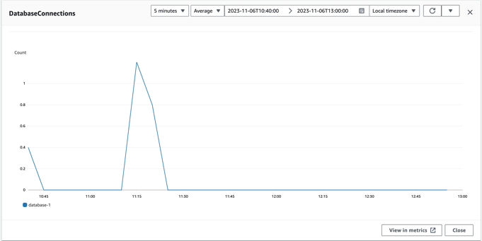
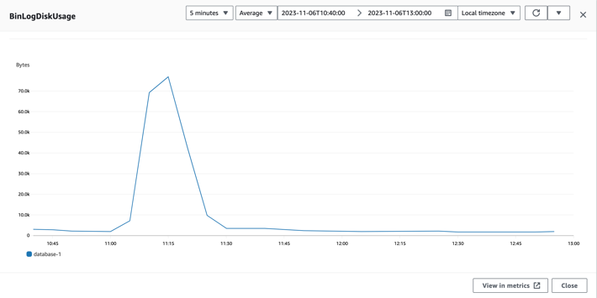
Performance Evaluation
Database Performance
2. Conducted performance evaluation for 150 students.

Slide 13
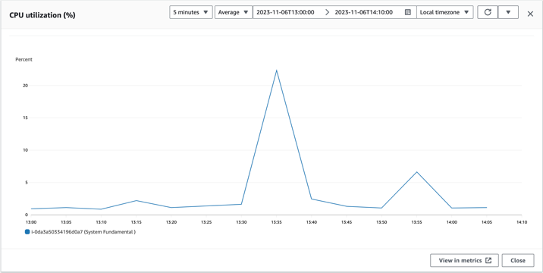
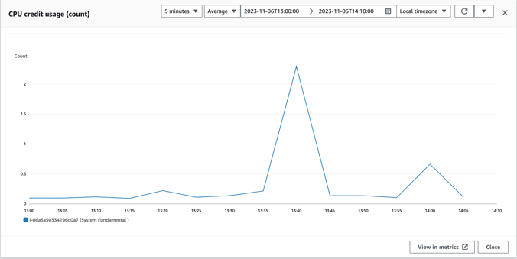
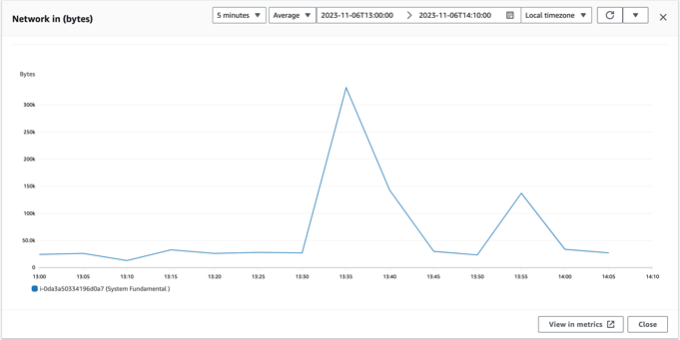
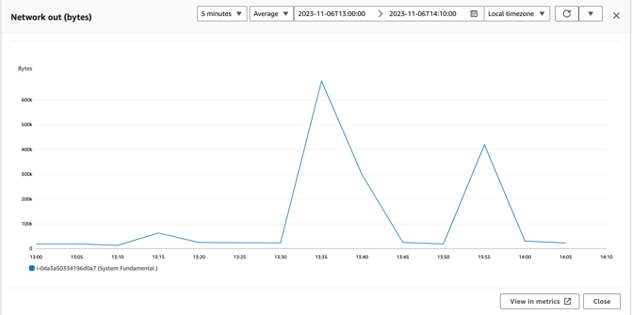
Performance Evaluation
Virtual Machine Performance
3. Ran software (Anaconda Navigator) inside the host machine and collected performance. Conducted performance evaluation for 50 students.

Slide 14
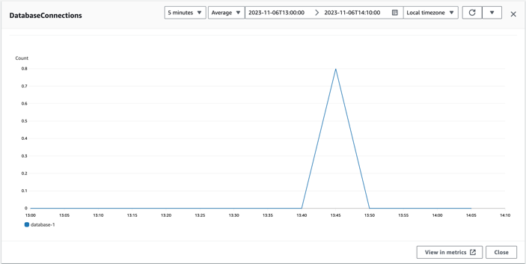
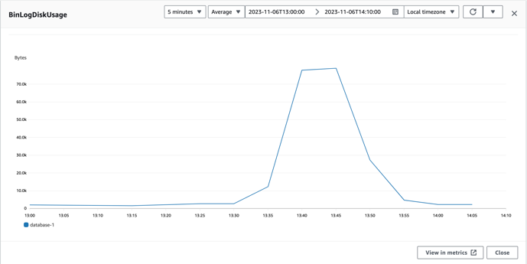
Performance Evaluation
Database Performance
3. Ran software (Anaconda Navigator) inside the host machine and collected performance. Conducted performance evaluation for 50 students.

Slide 15
Circumstances that faced difficulties in the project
Inbound and Outbound port issues.
AWS account was suspended.
Enable the Apache server and connect PHP.
Make the content responsive then target output is not able to show.

Slide 16
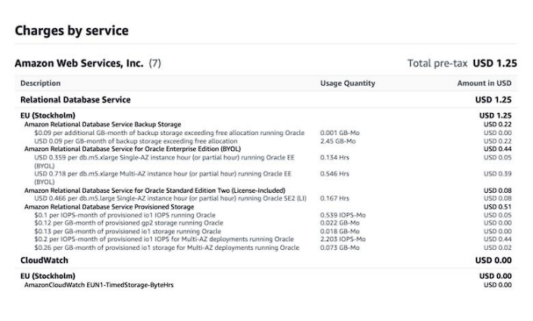
Cost of the project
An amount of USD 1.25 was spent on AWS Relational Database Service

Slide 17
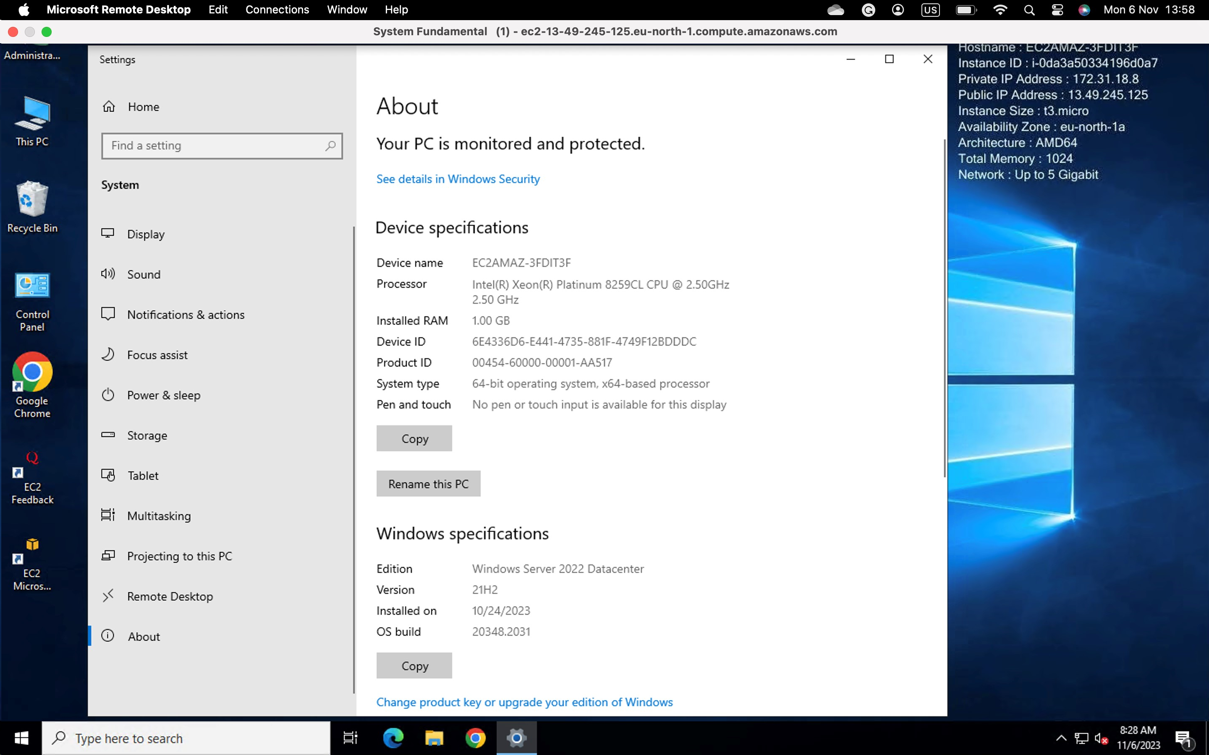
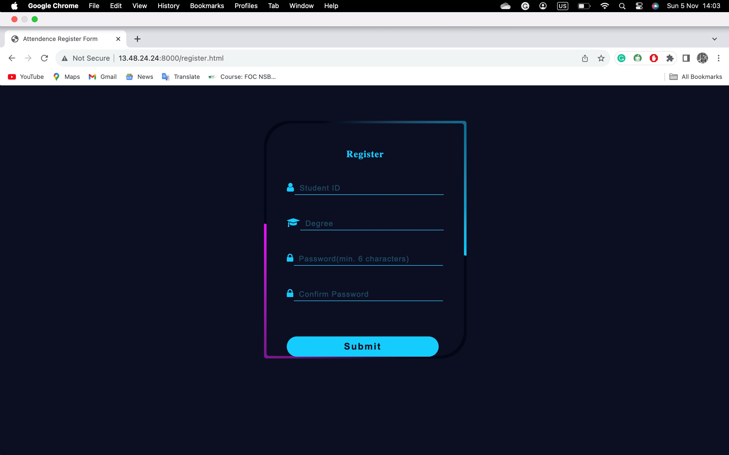
Project Methodology
AWS services including EC2 instances and RDS
implemented an Apache server r with PHP and MySQL for database management.
The website was developed using HTML, CSS, JS, and PHP files.

Slide 18
Project Outcome
The Fast QR Attendance System was successfully implemented, addressing the initial problem of system delays during attendance tracking. The system is now capable of handling attendance for a larger number of students efficiently and accurately

Slide 19
Conclusion
By leveraging AWS services and optimizing the system architecture, we have developed a robust solution for prompt student attendance tracking. This project not only resolves the identified problem but also demonstrates the scalability and reliability of cloud-based solutions in educational contexts.

Slide 20
Thank You...

